Slide 1

Nashville Housing Data Insights and Predictive Analytics Empowering Business Decisions with Data Science
Atajan Arashev December 2024

Slide 2

Presentation Overview
1)
Introduction
Project Objectives
Key Metrics and Data Overview
Database Design and Architecture
Database Tables and Relationships
Entity-Relationship Diagram (ERD)
Business Rules and Data Normalization
Data Analysis Framework
Key Analytical Views
Automated Data Retrieval Processes
SQL Functions and Procedures
Predictive Analytics Models
XGBoost: Training, Metrics, and Results
Artificial Neural Networks (ANN): Training, Metrics, and Results
Comparative Analysis: XGBoost vs. ANN
2)
Model Interpretability and Insights
SHAP Analysis for Feature Importance
Residual and Error Distribution Insights
Integration and Visualization
Automated Prediction Pipeline
Tableau Dashboards for Real-Time Insights
Business Impact and Decision-Making
Enhanced Pricing and Investment Strategies
Key Achievements and Stakeholder Benefits
Conclusion
Summary of Results and Impacts
Future Opportunities for Model and System Expansion

Slide 3

Objectives for the Project
Project Objectives
Automate Data Management
Streamline property data management and analysis through a well-structured database design.
Generate Actionable Insights
Create views, stored procedures, and functions to uncover valuable business insights such as ROI, tax calculations, and sales trends.
Predict Property Trends
Use machine learning models (ANN and XGBoost) to forecast property sale prices and identify undervalued properties.
Support Decision-Making
Equip property managers, investors, and stakeholders with tools to make data-driven decisions on valuation, investment, and portfolio management.
Enhance Reporting and Visualization
Integrate database outputs with Tableau to produce interactive dashboards for easy interpretation of property trends and market dynamics.
Scalability and Flexibility
Ensure the database can be scaled to include additional cities, property types, and advanced analytics in the future.

Slide 4
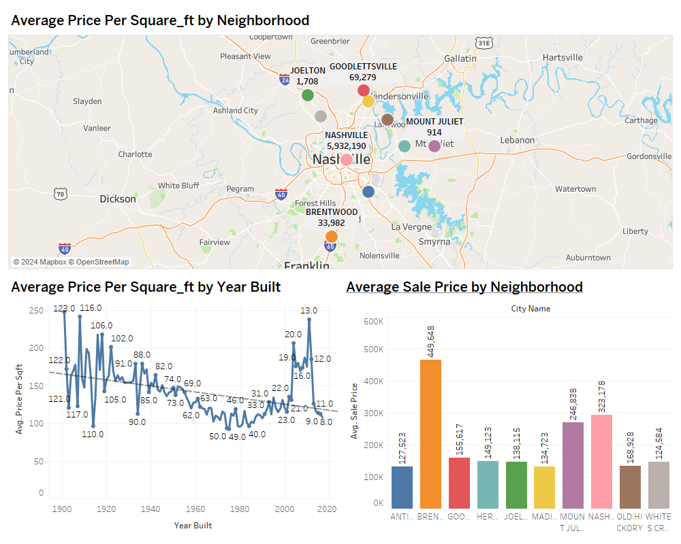
Database Overview
NASHVILLE
ANTIOCH
BRENTWOOD
MADISON
OLD HICKORY
HERMITAGE
GOODLETTSVILLE
WHITES CREEK
JOELTON
MOUNT JULIET
Tables and Descriptions
Properties
Stores property details (parcel ID, address, city, land use).
Valuation
Tracks land, building, and total valuations with sale price ratios.
Sales
Contains sales data (price, date, price per sqft, vacancy status).
Features
Provides property metadata (area, year built, grade, rooms).
Owners
Details about property owners (ID, name).
Ownership
Links properties to their owners.
Predictions (ANN)
Stores sale price predictions and actual prices (ANN).
XGPredictions
Contains sale price predictions and actual prices (XGBoost).
Cities
Lists city identifiers and names.
Land Use Mapping
Maps land-use codes to descriptions.
Acreage Ranges
Categorizes acreage with range descriptions.
Total Sales Value: $6,521,188,097
Average Sale Price: $274,912.02

Slide 5
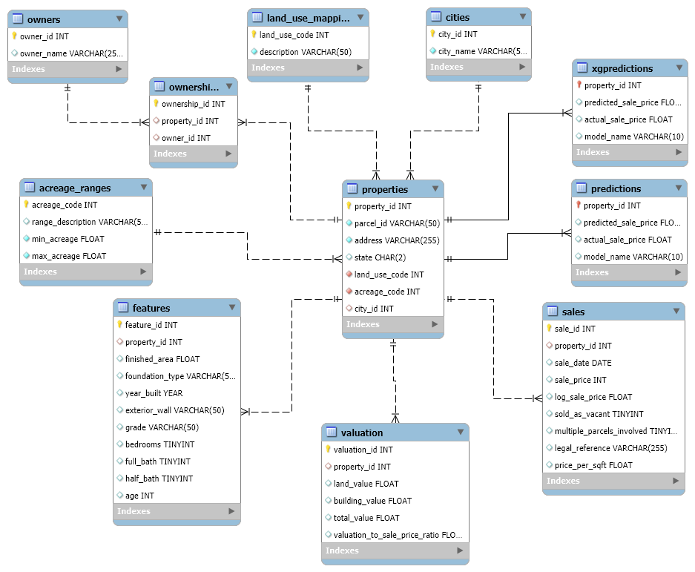
Database Structure and Relationships for Real Estate
This ERD shows how data is structured to link properties, transactions, and predictions, ensuring robust data management for analytics
Streamlined relationships ensure efficient data retrieval for machine learning predictions.
The normalization of data enables flexibility for business analyses like ROI and undervalued properties
Properties ↔ Valuation:
One property can have one valuation.
properties.property_id → valuation.property_id (1-to-1 relationship).
Properties ↔ Sales:
One property can have multiple sales records.
properties.property_id → sales.property_id (1-to-many relationship).
Properties ↔ Features:
One property can have multiple associated features.
properties.property_id → features.property_id (1-to-many relationship).
Properties ↔ Ownership ↔ Owners:
One property can have multiple owners (via the ownership table).
ownership.property_id → properties.property_id (1-to-many).
ownership.owner_id → owners.owner_id (many-to-1).
Properties ↔ Cities:
Each property belongs to one city.
properties.city_id → cities.city_id (many-to-1 relationship).
Properties ↔ Land Use Mapping:
Each property has one land-use type.
properties.land_use_code → land_use_mapping.land_use_code (many-to-1 relationship).
Properties ↔ Acreage Ranges:
Each property belongs to one acreage range.
properties.acreage_code → acreage_ranges.acreage_code (many-to-1 relationship).
Properties ↔ Predictions (ANN):
One property can have one set of predictions (ANN).
properties.property_id → predictions.property_id (1-to-1 relationship).
Properties ↔ XGPredictions:
One property can have one set of predictions (XGBoost).
properties.property_id → xgpredictions.property_id (1-to-1 relationship).

Slide 6
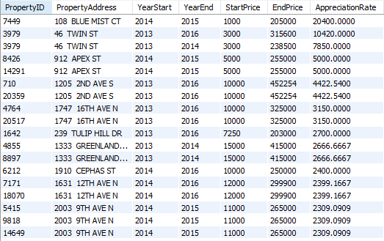
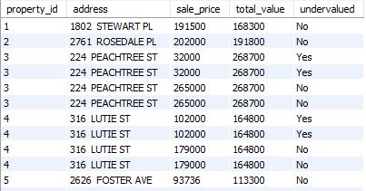
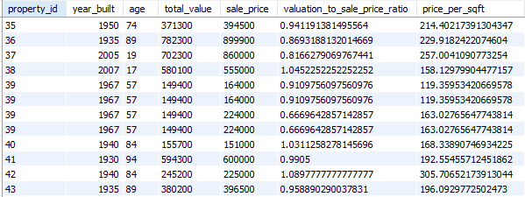
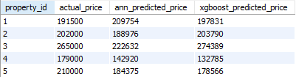
Analytical Views for Simplified Insights
yearlypropertyappreciation:
Displays yearly trends in property value growth.
Use Case: Analyze property appreciation for long-term investments.
Purpose:
Pre-defined SQL queries for faster and more efficient data analysis.
Aggregates data from multiple tables to provide actionable insights.
Key Views:
undervaluedpropertiesview:
Highlights properties with valuation-to-sale-price ratios
Use Case: Helps identify investment opportunities
property_analysis: Provides detailed insights on property attributes such as age, valuation, and sale price. Use Case: Enables pricing strategy evaluations and property trend analysis.
organized_predictions:
Summarizes predictions for property sale prices (ANN/XGBoost) along with actual values.
Use Case: Compare predicted vs. actual performance of models

Slide 7
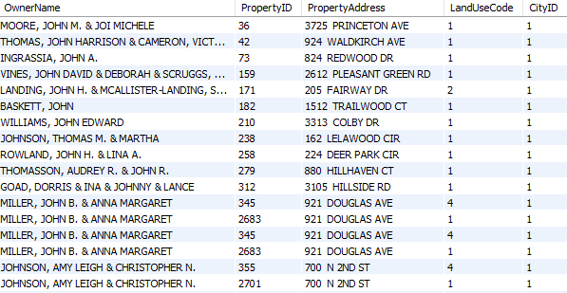
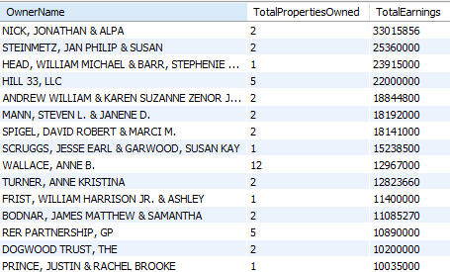
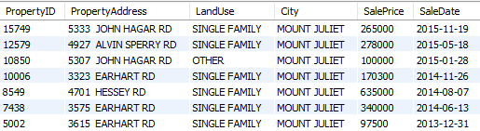
Automating Data Retrieval and Processing
Benefits:
Reduces the complexity of executing queries manually.
Ensures consistency and accuracy in data retrieval.
Saves time by automating multi-step processes.
FindPropertiesByOwner:
Purpose: Retrieves all properties owned by a specific individual or entity.
Example Output:
Visualize using the first table (top-left), showing OwnerName, PropertyID, and PropertyAddress.
RankOwnersByEarningsAndProperties:
Purpose: Ranks owners based on property count and earnings.
Example Output:
Use the OwnerName, TotalPropertiesOwned, and TotalEarnings table (bottom-middle).
Use Case: Highlights top-performing clients for business decisions.
GetPropertiesByCity:
Purpose: Retrieves all properties in a specific city.
Example Output:
Show the City, PropertyAddress, LandUse, and SalePrice table (middle-bottom).
Use Case: Useful for city-level market analysis.

Slide 8
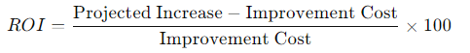
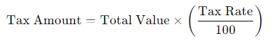
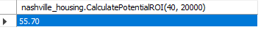
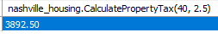
Functions
calculatePropertyTax
Purpose:
Computes the property tax based on its total value and a given tax rate.
Inputs:
propertyID: The unique ID of the property.
taxRate: Tax rate as a percentage.
Logic:
Retrieves the total value of the property from the valuation table.
CalculatePotentialROI
Purpose:
Calculates the potential Return on Investment (ROI) for a property based on its current value, projected increase, and improvement cost.
Inputs:
propertyID: The unique ID of the property.
improvementCost: Cost of improvements made to the property.
Logic:
Retrieves the current total value of the property from the valuation table.
Assumes a 20% projected increase in value.
Return Value:
The calculated ROI as a percentage.
Example Use Case:
Evaluate whether improvements to a property will yield a profitable return.
Return Value:
The calculated tax amount.
Example Use Case:
Automate property tax calculations for financial reports or tax filings.

Slide 9
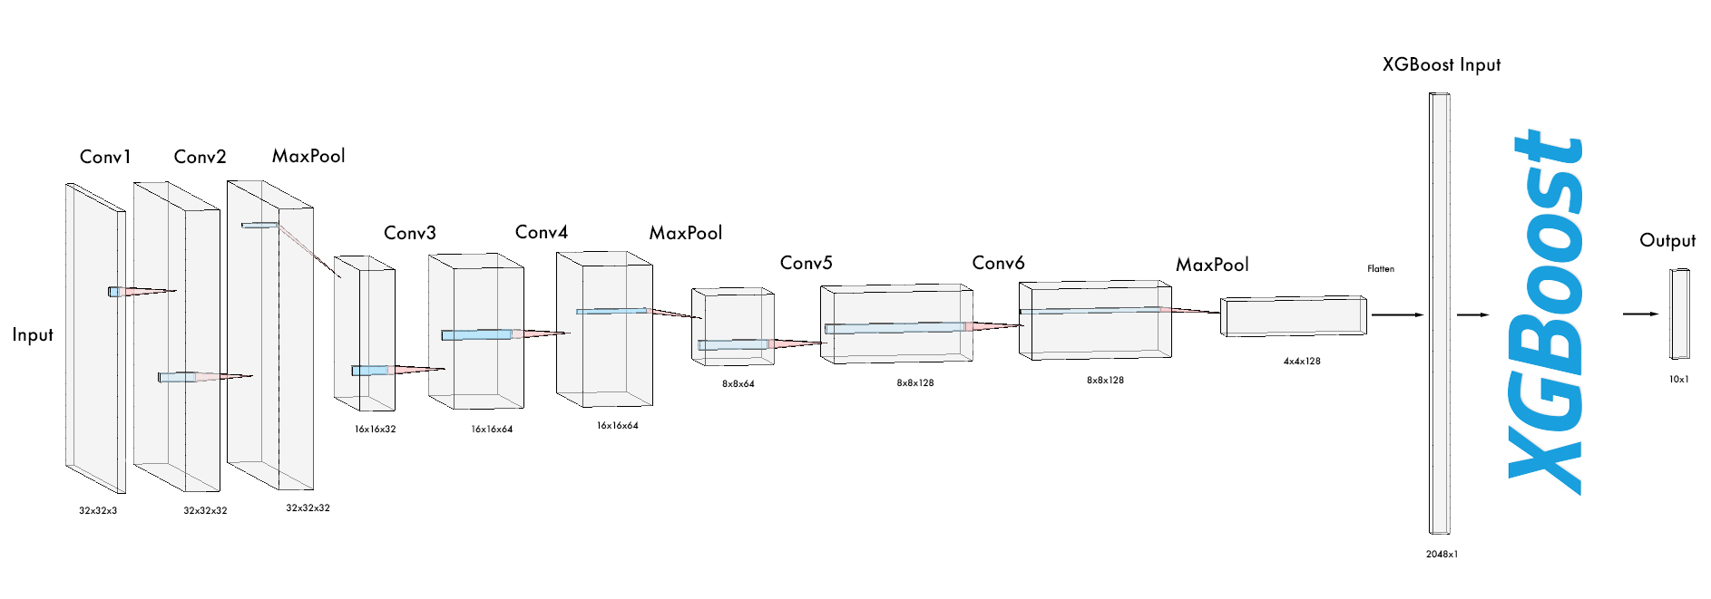
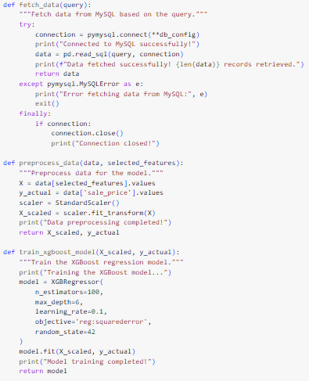
XGBoost Model for Predictive Analytics
Workflow Steps:
Data Integration:
Combined data from properties, valuation, features, and sales tables using SQL.
Selected relevant features for training.
Data Preprocessing:
Applied StandardScaler for normalization.
Features selected:
total_value, building_value, land_value
bedrooms, full_bath, half_bath
age, valuation_to_sale_price_ratio, price_per_sqft
Model Training:
Algorithm: XGBoost Regressor.
Parameters:
n_estimators: 100
max_depth: 6
learning_rate: 0.1
Objective: reg:squarederror (minimizing squared error).
Prediction Integration:
Stored predictions in xgpredictions table using property_id as the primary key.
Ensured up-to-date predictions with SQL ON DUPLICATE KEY UPDATE.
Results:
Successfully trained on 51,076 records.
Predictions for 63,616 properties stored in MySQL.

Slide 10
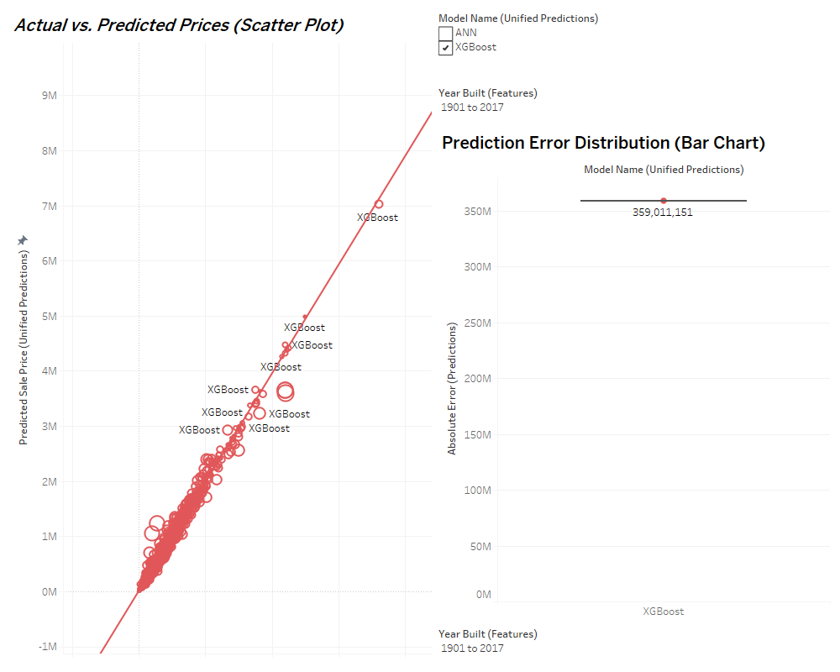
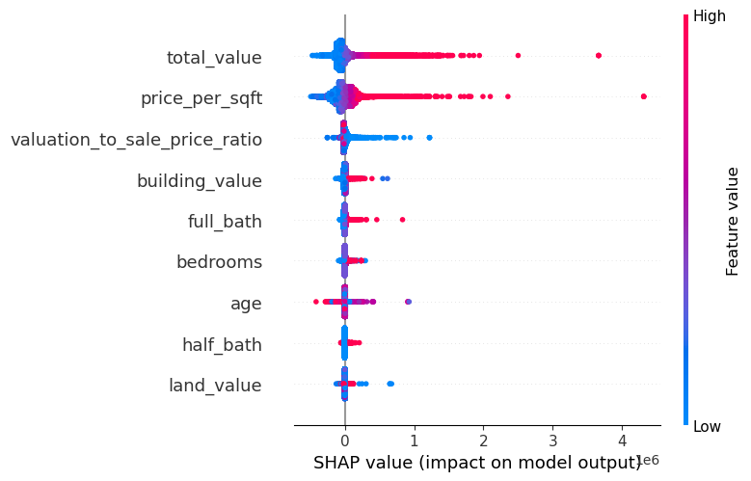
XGBoost Feature Importance and Prediction Explanation
Key Metrics
Performance Overview:
Mean Absolute Error (MAE): 17,257.64
Root Mean Squared Error (RMSE): 28,110.44
Mean Squared Error (MSE): 790,196,914.43
Purpose: These insights enable data-driven pricing strategies and identify key features influencing property value
Data points closely aligned with the diagonal represent accurate predictions.
Points deviating indicate higher errors.
XGBoost's absolute error is concentrated around 359M, showing model performance trends.
Alignment of predicted sale prices with actual values demonstrates XGBoost's reliability.
Error distribution emphasizes areas for improvement in prediction consistency
Charts are filtered to show predictions for properties built between 1901 and 2017
SHAP Summary: Detailed feature impact across all records.
SHAP (SHapley Additive exPlanations) provides a way to interpret the predictions:
Positive SHAP values push predictions higher.
Negative SHAP values reduce predictions.

Slide 11
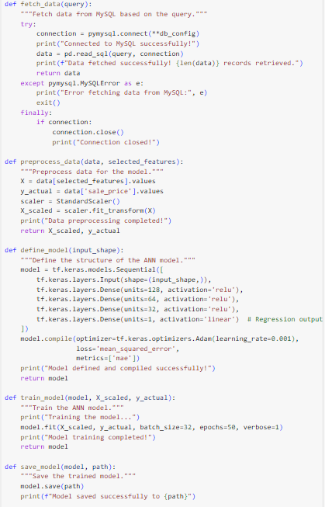
Artificial Neural Network (ANN) for Predictive Analytics
Data Integration
Combined data from properties, valuation, features, and sales tables using SQL.
Features selected: total_value, building_value, land_value,
bedrooms, full_bath, half_bath,
age, valuation_to_sale_price_ratio,
price_per_sqft.
Data Preprocessing
Applied StandardScaler for feature normalization to ensure consistent scale across variables.
Preprocessed data used as input to the neural network for optimized performance.
Model Training
Architecture:
Input Layer: Maps the normalized input features.
Hidden Layers: 3 dense layers with 128, 64, and 32 neurons, respectively.
Output Layer: Single neuron with a linear activation function for regression output.
Activation Functions: ReLU (Rectified Linear Unit) for hidden layers to introduce non-linearity.
Optimizer: Adam, a popular optimizer for efficient gradient-based optimization.
Loss Function: Mean Squared Error (MSE), minimizing the squared differences between predicted and actual prices.
Metrics: Mean Absolute Error (MAE) used to evaluate performance during training.
Model Training Results
Epochs: 50 training cycles were performed.
Loss values steadily decreased, indicating improved fit.
Achieved Mean Absolute Error (MAE): 74,416, Mean Squared Error (MSE): 26.6B, Root Mean Squared Error (RMSE): 162,996.
Prediction Integration
Predictions generated for 51,076 records.
Updated MySQL database with predictions in a dedicated table predictions.
Successfully trained on 51,076 records.
Predictions for 49,648 properties stored in MySQL.

Slide 12
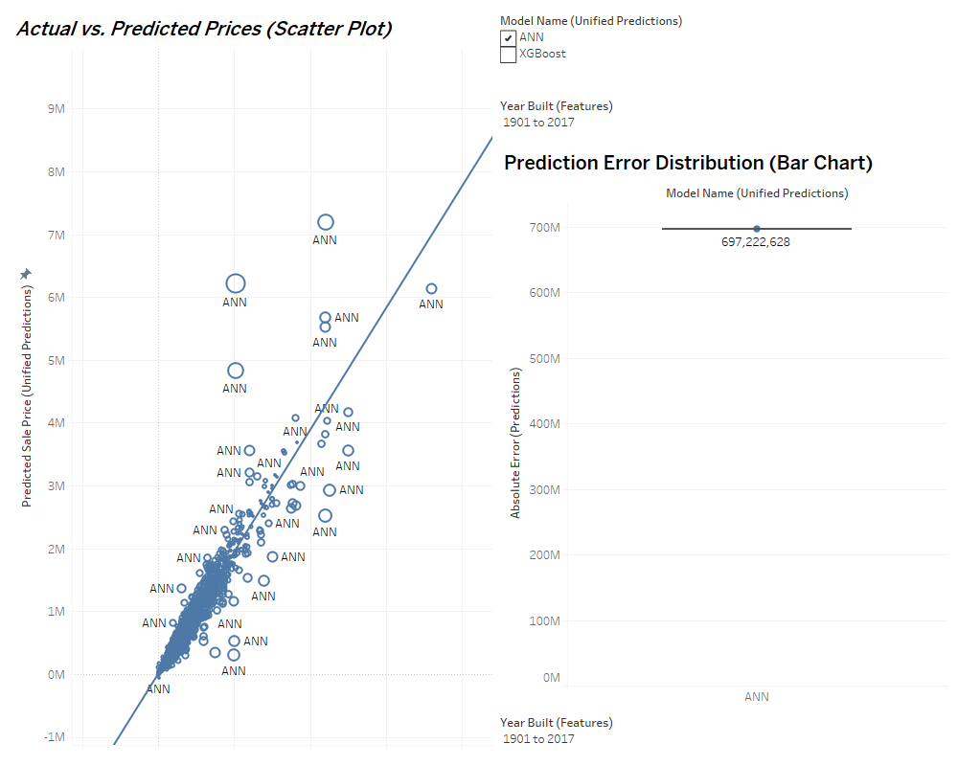

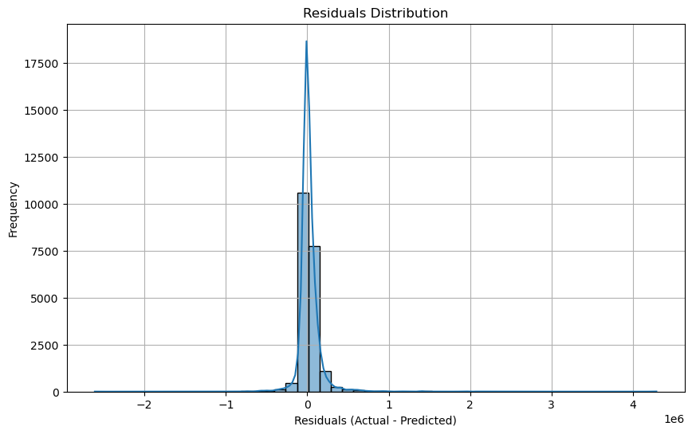
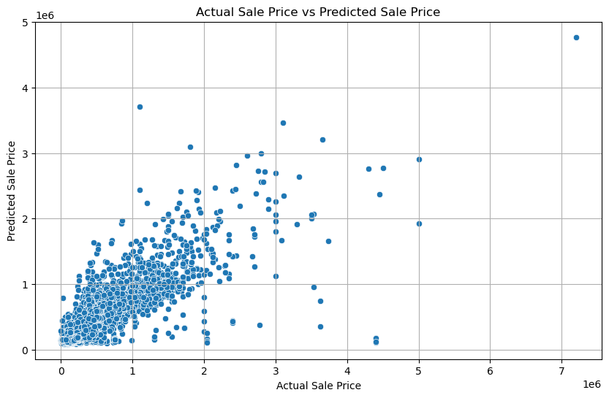
Performance Insights: ANN Model Prediction Analysis
Key Metrics:
Mean Absolute Error (MAE): 74,415.87
Root Mean Squared Error (RMSE): 162,996.10
Mean Squared Error (MSE): 26,567,729,903.46
Residuals Distribution
Purpose: Visualizes the difference between actual and predicted sale prices. Residuals closer to zero indicate better accuracy.
Key Insights:
Majority of residuals cluster around zero, reflecting strong model performance.
A symmetrical distribution shows minimal prediction bias.
Outliers highlight properties where the model struggled, suggesting areas for improvement.
Business Impact: Identifies high-performing predictions and outliers, helping refine strategies for pricing and valuation.
Actual vs. Predicted Sale Prices Scatter Plot
Purpose: Compares predicted sale prices with actual values to evaluate accuracy visually.
Key Insights:
Data points aligned along the diagonal indicate precise predictions.
Deviations highlight cases with lower prediction accuracy, especially for higher-priced properties.
Strong alignment for mid-range prices shows the ANN model performs reliably within this range.
Business Impact: Builds trust in the ANN model for mid-range pricing predictions and emphasizes outliers for potential review.

Slide 13
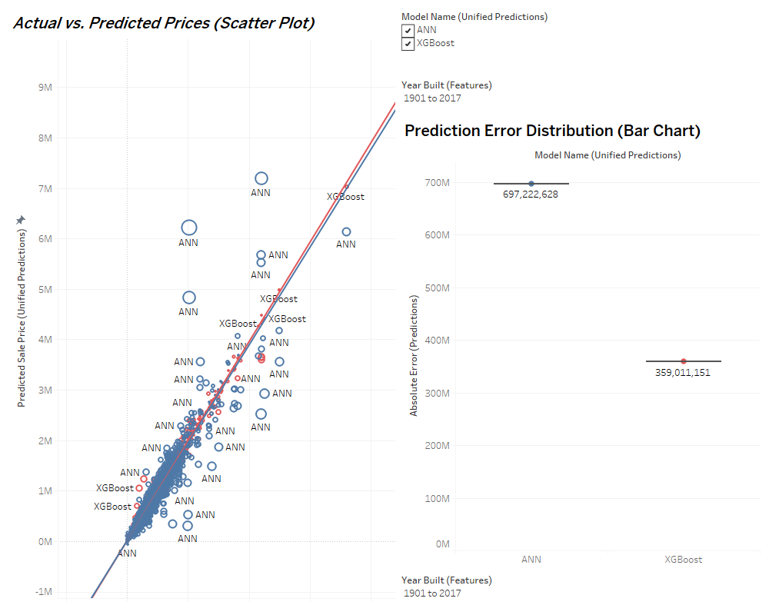
Comparative Analysis: ANN vs. XGBoost Models
Objective: To evaluate and compare the predictive performance of XGBoost and ANN models on the Nashville housing dataset, focusing on metrics, visualizations, and business implications.
Visual Insights:
Residual Distribution:
XGBoost: Residuals are tightly clustered around zero, indicating minimal bias and consistent accuracy.
ANN: Wider residual spread suggests larger prediction deviations, particularly for higher-priced properties.
Actual vs. Predicted Prices:
XGBoost: Strong alignment along the diagonal demonstrates precise predictions across price ranges.
ANN: Visible deviations for higher-priced properties indicate areas where the model struggled.
Error Distribution:
XGBoost: Concentration of errors near lower ranges reflects consistent reliability.
ANN: Error spread indicates less precision, with higher discrepancies in predicted outcomes.
Performance Metrics:
XGBoost: Lower MAE and RMSE values indicate higher accuracy in predictions.
ANN: Relatively higher error metrics suggest challenges in capturing complex relationships compared to XGBoost.
Metric | XGBoost | ANN
Mean Absolute Error (MAE) | 17,257.64 | 74,415.87
Mean Squared Error (MSE) | 790,196,914.43 | 26,567,729,903.46
Root Mean Squared Error (RMSE) | 28,110.44 | 162,996.10
Business Implications:
XGBoost:
Ideal for applications requiring high accuracy, such as pricing strategies and investment recommendations.
Reliable for properties with mid-to-high price ranges due to low prediction error.
ANN:
Suitable for broader market trend analysis where exact pricing precision is less critical.
Highlights areas for improvement in feature engineering or model tuning.

Slide 14
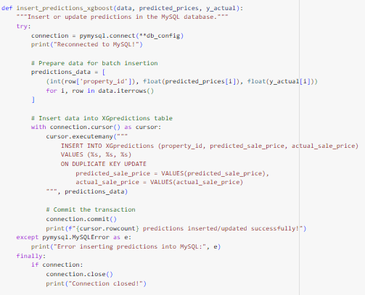
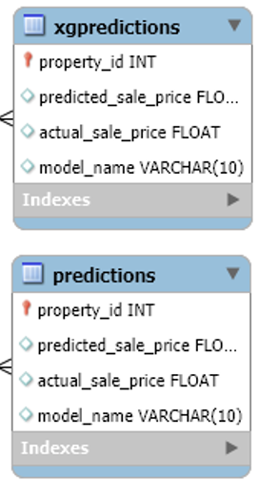
Automated Prediction Pipeline and Database Integration
Example:
Pipeline Overview
Data Integration:
SQL queries retrieve property, valuation, feature, and sales data.
Selected features such as total_value, building_value, price_per_sqft, and year_built are preprocessed.
Model Training:
XGBoost Model: Trained with XGBRegressor, focused on fast predictions with fine-tuned hyperparameters.
ANN Model: Multi-layered architecture (3 hidden layers) trained for accurate regression.
Prediction Generation:
Both models generate predictions for all properties.
Predictions are stored in two separate MySQL tables:
XGpredictions: For XGBoost predictions.
predictions: For ANN predictions.
Automated Updates:
SQL ON DUPLICATE KEY UPDATE ensures real-time updates for both tables.
Newly added property records are automatically included in the pipeline and updated in the database.
Business Impact
Efficiency: Automates prediction generation and database updates without manual intervention.
Scalability: Integrates new property records dynamically, ensuring predictive models remain up-to-date.
Decision Support: Enables stakeholders to access real-time predictions for informed decision-making.

Slide 15

Conclusion: Insights and Impact of the Nashville Real Estate Project
Project Summary
Successfully developed an end-to-end pipeline for real estate price prediction, starting with database creation in MySQL using CSV data imports via Python.
Designed and implemented automated data engineering workflows to preprocess and manage large datasets.
Integrated XGBoost and ANN models for predictive analysis, achieving robust performance and actionable insights.
Key Achievements
Database Creation & Management:
Imported CSV files into a structured MySQL database using Python scripts, ensuring clean and organized data storage.
Enabled seamless data integration from multiple sources (properties, valuation, features, sales).
Performance Excellence:
XGBoost: Delivered high accuracy with MAE: 17,257.64, RMSE: 28,110.44.
ANN: Showcased scalability with MAE: 74,415.87, RMSE: 162,996.10.
Feature Importance:
Identified influential factors like total value, price per square foot, and valuation-to-sale price ratio using SHAP analysis.
Data Automation:
Designed a scalable pipeline to process, predict, and store results in MySQL, ensuring predictions are always current.
Business Impact
Enhanced Decision-Making: Provided stakeholders with reliable price predictions and insights for market strategies.
Automation & Scalability: Enabled the system to adapt to new data entries seamlessly, supporting continuous model updates.
Optimization: Highlighted areas for refining pricing strategies and improving property evaluations.
Future Opportunities
Model Expansion: Incorporate additional models like ensemble learning or time-series forecasting.
Advanced Insights: Extend SHAP analysis to identify granular impacts of features.
Real-Time Dashboards: Integrate with Tableau for live visualizations and deeper business intelligence.

